Slide 1

PERSONAL
INITIATIVE
Self-Starting

Slide 2


WHAT YOU NEED TO DO Self-Starting
Don’t react to what’s happening around you. Act first to outperform your competitors!
DON’T copy competitors, you must offer something different.
If your circumstances are challenging, actively work to change them.
Think before you act - random actions are useless.
But: Be quick – you’ve got to collect feedback before implementing actions
It is actions that turn ideas into reality - get up and do it!
Notes:
Reduce number of action principles.
+ Improve quality of English. Simple but clear English.
Eliminate #2
Keep in mind: Are we working with illiterates?
Many action principled may be useful to revise & explain material.
Few action principles are easier for remembering them.

Slide 3

REACTIVE AND PROACTIVE BEHAVIOUR
LAID BACK | GET UP AND DO IT!
Imitate/copy exactly what competitors are doing | Being different - doing something new Learn from others, but be different
Complaining about things and hoping they will get better | Changing difficult circumstances
Waiting for people to give you information | Actively seeking information
Rely only on what you already know Waiting for ideas to show themselves Wait for the right circumstances to realise your ideas Sticking to old habits FAILURE | Actively seeking new ideas Seeking opportunities to learn Realise your ideas now Trying new methods SUCCESS!

Slide 4
Changing Difficult Circumstances
When situations are difficult change them!
With life threatening danger mounting for her people (and also herself), Esther bravely stepped forward to change the circumstances
Esther 4: 12-15

Slide 5



JUMP OUT OF YOUR COMFORT ZONE!
Look for new ideas and opportunities!
SELF-STARTING
Be different!
YOUR REGULAR WORK
Offer new products/services!
Learn new things!
Introduce a new way of making/selling/offering!
Set a goal and plan!
Notes:
Slides 14-16 maybe a little bit too similar
→ Can be reduced?

Slide 6

EXERCISE
Instruction:
This exercise presents two case studies of women entrepreneurs in Kenya
The first female entrepreneur shows Get Up & Go! behaviour while the second female entrepreneur shows Laid Back behaviour.
Form groups of Four (04) people to work on this exercise.
Groups A:
Look at case 1 « Get Up & Go female entrepreneur".
Identify and record what is proactive in their behaviour and the consequences of this.
Groups B :
Then look at case 2 « Laid Back female entrepreneur".
Identify and note what is reactive in their behaviour and the consequences of this.
WS 1
WS 2

Slide 7
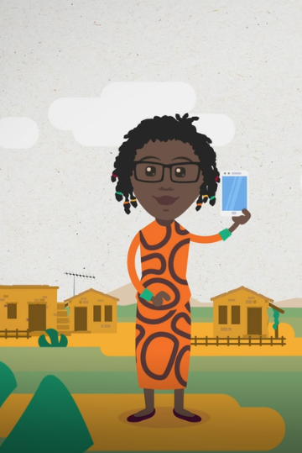
GET UP & GO! ENTREPRENEUR: ANNIE
WS 1
Hello, I am Annie. I produce and sell herbs from my region. Before that, I worked in a food laboratory for four years. To learn how to run a business, I regularly watch videos on the internet about accounting and management. My business has grown steadily over the past few years. I recently set myself the goal of doubling my turnover within a year. To get higher prices for my products, I tried to contact a supermarket in Nairobi. As no one responded to me, I asked a friend, who works for the supermarket, to take a sample of my products to his manager. In this way, I was able to attract the attention of the management and began collaborating with the supermarket.
To deliver my products to the supermarket, I work with a local farmer, who often travels to Nairobi. I’m also working to ensure my products are certified 'organic’, because I believe organic products will be in greater demand in the coming years and I will be able to get a better price for them.
What is Annie's active behaviour? | What are the consequences of this behaviour?

Slide 8
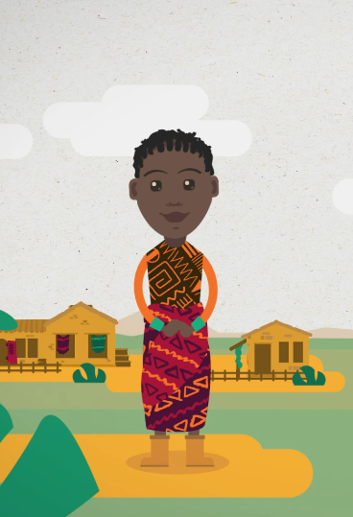
LAID BACK ENTREPRENEUR: PAULINE
WS 2
Hello, my name is Pauline. I learned about the production and marketing of herbs from my parents. When they got older, I took over their business and basically stuck to their business routine because it worked okay for them. I never really looked for new ways to do anything, like increase production or improve marketing.
However, one of my main problems is packaging and selling my herbs. It takes a long time to get into Nairobi to buy the packaging I need. As a result, I avoid travelling if possible, but that means I can run out of boxes and bags for my products. For the same reason, I don’t usually attend the big trade markets where my competitors exhibit their products and look for business partners. Slower sales also mean I lack space to store my products. I can’t really think of anything I can do to change these problems; I’m just hoping one day there will be a new road to Nairobi.
What is Pauline's reactive behaviour? | What are the consequences of this behaviour?

Slide 9
EXERCISE Self-Starting
Example: Daily routine of a small grocery shop owner
Time Activities
8.00
Open the shop and put up the usual advertising outside the shop.
Wait for the first customer.
Telephone call from the supplier: he will not be able to deliver fresh fruit today.
This is already the third time this has happened in a fortnight. Hopefully it will get better soon.
Customer service. Some people leave the shop without buying anything because they are only looking for fresh fruit. Send these customers to the competitor on the next street.
Not many customers today, use the time to call friends and start chatting.
Cleaning of the shop front and signage.
Closing of the shop.
Counting sales and calculating turnover for today - a bad day...
Instruction:
Review this shop owner’s routine and identify where they should be more Go-Getting!
- 8.45
9.00
9.30
11.00
1.00
4.30
Notes:
Adapt the example based on suggestion. Immediately ADD more proactive behaviours.

Slide 10

EXERCISE Self-Starting
WS
3
Instruction:
Work in groups of ~Two (02) people.
Each write down activities from your most recent working day
What went wrong?
Where have you been Active? Where have you been Laid Back?
What more active behaviours could you have used instead?
Share with your partner

